Slide 1

Dental Amalgam Control Program
Implementation & Training Presentation
Metro Wastewater Reclamation District
1

Slide 2
Outline
New Federal Regulations Effective 07/14/17, and Revised Metro District Rules & Regulations Effective July 2, 2018
Best Management Practices (BMPs)
Amalgam Separator Installation & Maintenance
Operations & Maintenance (O&M) Plan
Record Keeping Requirements
Reporting Requirements and Inspections

Slide 3

New Federal Regulations and
Revised Metro District Rules & Regulations
New Federal Regulations
(Effective July 14, 2017)
40 Code of Federal Regulations (CFR) Parts 441.30-441.50
Revised Metro District Rules & Regulations (Effective July 2, 2018)
Section 6.16.1
What’s Changed?
No later than July 14, 2020, existing dental facilities must:
Install and maintain a properly sized amalgam separator meeting ISO 11143 and at least a 95% removal efficiency.
Implement Best Management Practices (BMPs), including the use of a neutral line cleaner with a pH between 6-8. Additionally, waste amalgam including, but not limited to, dental amalgam from chair-side traps, screens, vacuum pump filters, dental tools, cuspidors, or collection devices, must not be discharged to a POTW.
Submit a one-time compliance report, applicable to both facilities that do and do not place amalgam, and maintain amalgam-related records on site.
No later than July 14, 2020, existing dental facilities must:
Install and maintain a properly sized amalgam separator meeting ISO 11143 and at least a 95% removal efficiency.
Develop and submit to the Metro District an Operations & Maintenance Plan (O&M Plan) ensuring the proper operation and maintenance of all amalgam separators and disposal of all amalgam wastes. (See Slide 12)
Implement Best Management Practices (BMPs) including the two in the Federal Regulations and those outlined in Slides 5-7 of this presentation.
Maintain all amalgam-related documentation, including One-Time Compliance Reports, amalgam-retaining container replacement recycling receipts, manifests and documentation of any amalgam separator repair or replacement.
Submit a one-time compliance report, applicable to both facilities that do and do not place amalgam.
A One-Time Compliance Report (unless a business moves, changes ownership, or has significant changes), has replaced the Annual Dental Certifications previously required.
Due date for compliance with all regulations and the submittal of the One-Time Compliance Report for existing dental facilities updated so regulations match: Due July 14, 2020. Any new facility opened after July 14, 2017, must be in compliance and submit the One-Time Compliance Report no later than 90 days after initial commencement of discharge to the Metro District.
The One-Time Compliance Report must be accompanied by a copy of the facility’s O&M Plan.
The Metro District will be inspecting facilities more frequently to verify compliance and conduct enforcement, if necessary.
Line cleaners must now have a pH between 6-8.

Slide 4

Best Management Practices (BMPs)
Metro Wastewater Reclamation District ~ Dental Amalgam Control Program
Rules & Regulations, Section 6.16.1, CFR 441.30

Slide 5

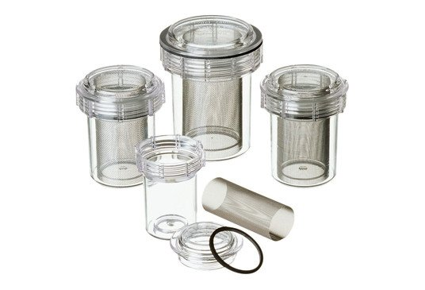
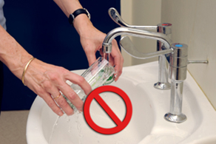
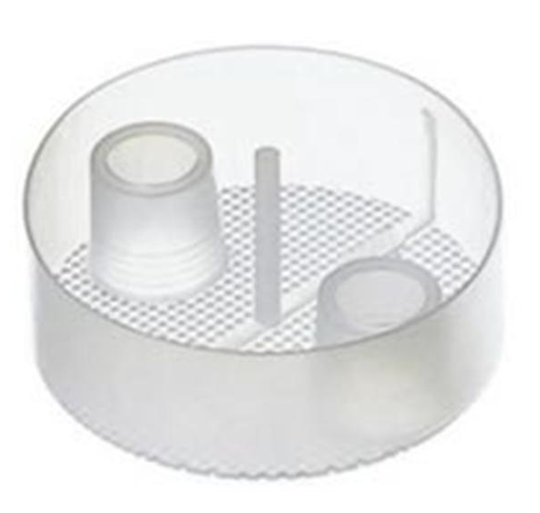
Best Management Practices (BMPs)
Best Management Practices (BMPs) are control measures required of the dental facility to prevent or control the disposal of mercury and other metals in the form of restorative amalgams.
Use only pre-capsulated, single-use amalgam. Bulk mercury must not be used, and any remaining bulk mercury must be appropriately recycled.
All dental chairs at which dental amalgam may be present in the resulting wastewater shall be equipped with disposable chair-side traps and all vacuum pumps shall be equipped with traps or filters. All equipment must be cleaned and maintained in accordance with the manufacturer’s instructions.
Do not rinse screens, filters, traps, amalgam separators or any other amalgam-containing equipment over sinks or drains!

Slide 6
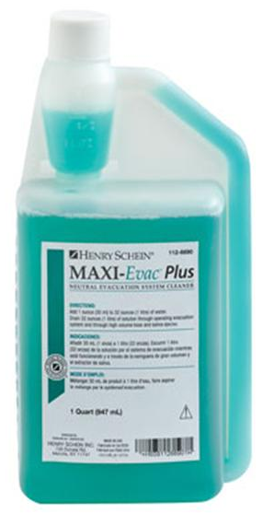
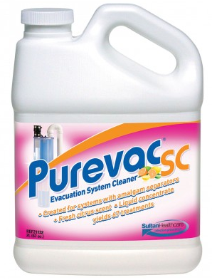
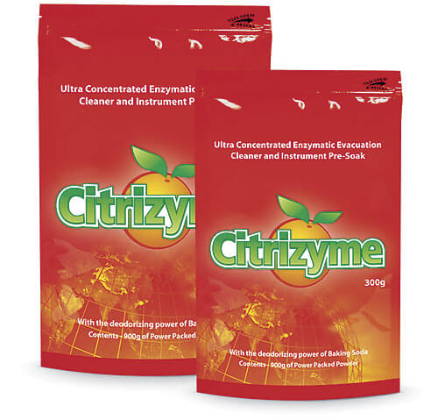
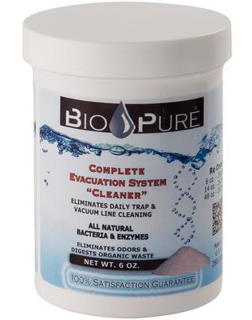
Best Management Practices (BMPs)
(Continued)
Only use non-chlorine, non-oxidizing disinfectants and neutral cleaners, with a pH between 6 and 8. Chlorinated, oxidizing cleaners will cause mercury to dissolve and pass through the amalgam separator system.
The Metro District does not endorse any line-cleaning brands, but the products pictured are known to meet the pH 6-8 requirement. We recommend you consult with your dental supply company for an acceptable product, and that you review the Safety Data Sheet (SDS) prior to purchase to verify that it qualifies under the Regulations.

Slide 7
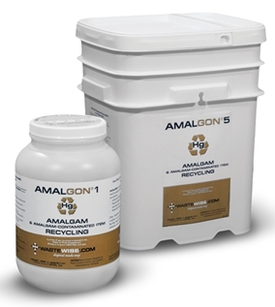
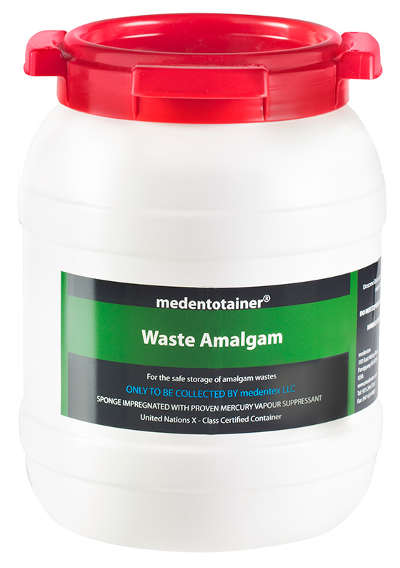
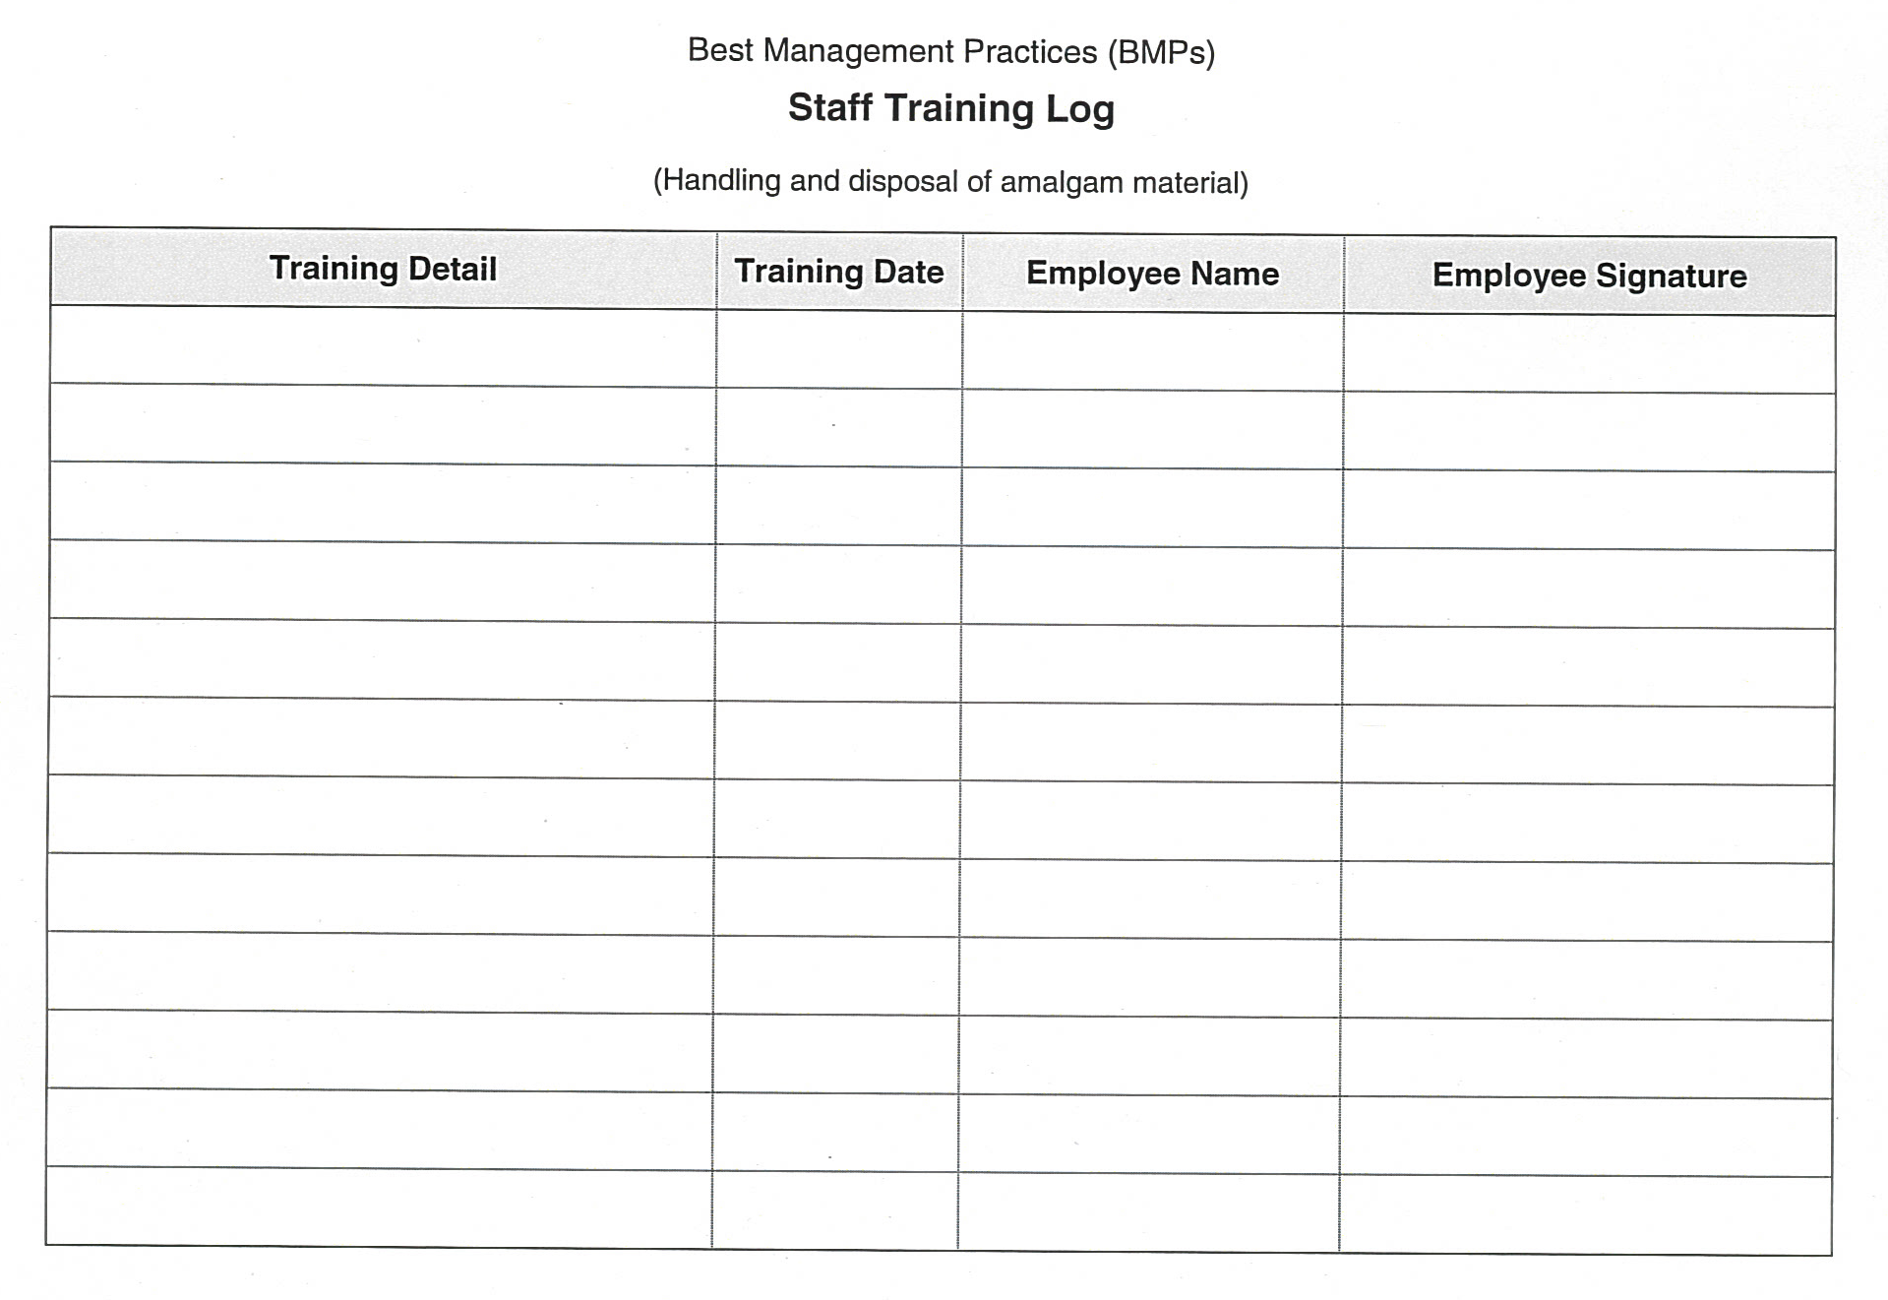

Best Management Practices (BMPs)
(Continued)
All contact and non-contact amalgam scrap must be salvaged and stored in structurally sound, tightly closed, and appropriately labeled containers.
Staff must be trained in the proper handling and disposal of amalgam material and maintain a log documenting such training.
At no time should amalgam waste be disposed of or flushed down the drain or toilet!

Slide 8

Amalgam Separator Installation & Maintenance
Metro Wastewater Reclamation District ~ Dental Amalgam Control Program
Rules & Regulations, Section 6.16.1, CFR 441.30

Slide 9
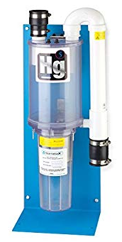
Amalgam Separator Installation & Maintenance
All amalgam-containing wastewater must be discharged through an amalgam separator.
Amalgam separators must comply with ISO 11143 standards and be designed with a minimum removal of 95% solids, unless otherwise approved by the Metro District.
Amalgam separators must be properly sized for the volume and flow of the dental facility’s amalgam wastewater in accordance with the manufacturer’s specifications and recommendations.
Amalgam separators must be installed, operated and maintained according to the manufacturer’s operating manual.
In the event that an amalgam separator is not functioning properly, the amalgam separator must be repaired consistent with manufacturer instructions or replaced with a unit that meets the requirements of CFR 441.30 as soon as possible, but no later than 10 business days after the malfunction is discovered.

Slide 10

Quote and Image Slide
“
A true conservationist is a man who knows that the world is not given by his fathers, but borrowed from his children.
~ John James Audubon
10

Slide 11
Operations and Maintenance (O&M) Plan
Metro Wastewater Reclamation District ~ Dental Amalgam Control Program
Rules & Regulations, Section 6.16.1, CFR 441.30

Slide 12
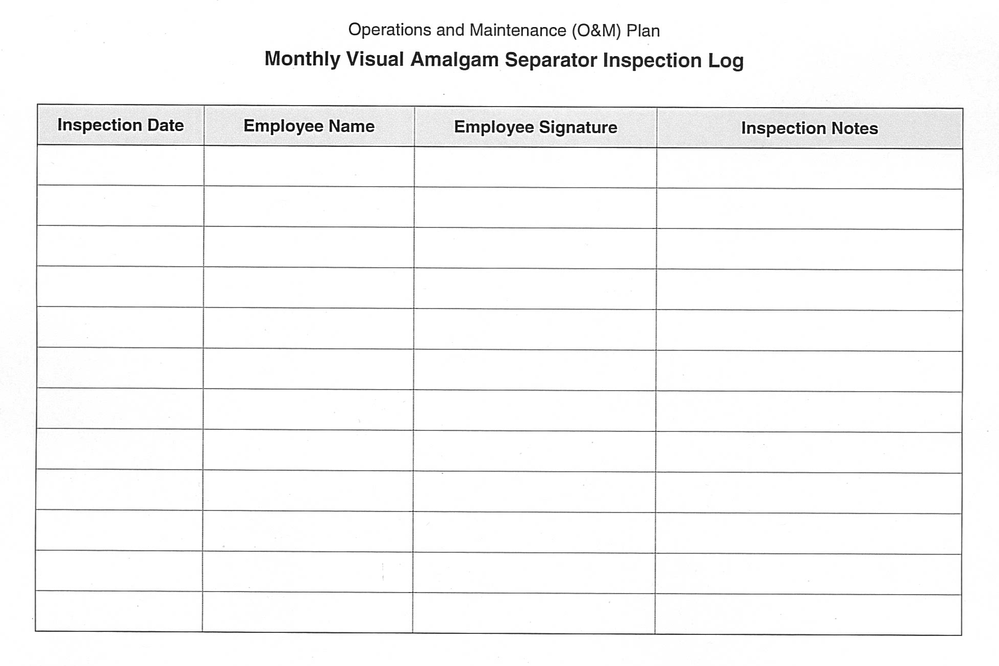
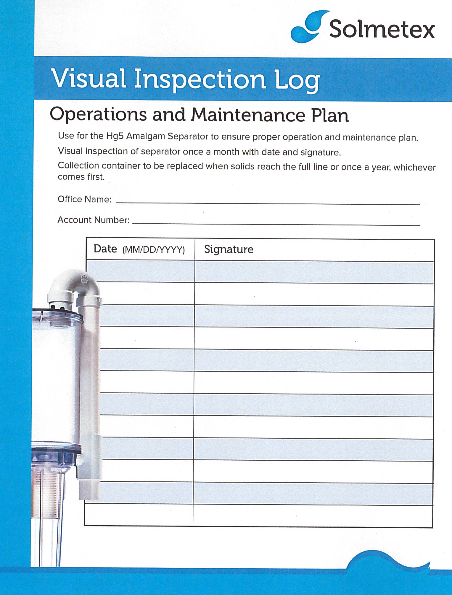
Operations and Maintenance (O&M) Plan
Each dental facility must develop an O&M Plan to ensure proper operation and maintenance of all amalgam separators and documentation of all maintenance activities. This plan must be kept current and must address, at a minimum, the following:
Required maintenance according to the manufacturer’s recommendations must be performed and documented.
A monthly visual inspection of the amalgam separator(s) must be performed, and a monthly amalgam separator inspection log must be maintained with dates and personnel signatures.
Collection device replacement per the manufacturer’s recommendation or when solids reach the full line, whichever comes first.
Amalgam wastes should be transferred to an off-site mercury recycling facility or managed and disposed of in accordance with applicable federal, state and local hazardous waste laws and regulations.

Slide 13
Record Keeping Requirements
Metro Wastewater Reclamation District ~ Dental Amalgam Control Program
Rules & Regulations, Section 6.16.1, CFR 441.50

Slide 14
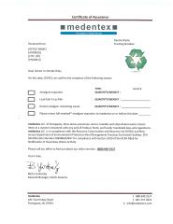
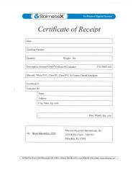
Record Keeping Requirements
Excluding the One-Time Compliance Report which must be maintained as long as the dental facility is in operation or ownership is transferred, the following documentation shall be established and maintained in either physical or electronic format for no less than three(3) years and made available for Metro District review upon request.
Documentation of all dates that collected dental amalgam is picked up or shipped for proper disposal in accordance with 40 CFR 261.5 (g)(3) including copies of receipts, manifests, and other documents that include the date(s) of the amalgam waste collection and the name of the permitted or licensed treatment storage or disposal facility receiving the amalgam retaining container.
Documentation of any repair or replacement of an amalgam separator or equivalent device, including the date, person(s) making the repair or replacement and a description of the repair or replacement (including make and model).

Slide 15

Reporting Requirements & Inspections
Metro Wastewater Reclamation District ~
Dental Amalgam Control Program
Rules & Regulations, Sections 6.16.1 and 6.25
CFR 441.10 & 441.50
  Compliance Reporting
  De Minimus and Exempt Facilities
  Inspections
  Right of Entry
  Non-Compliance
15

Slide 16
Reporting Requirements & Inspections
Compliance Reporting
De Minimus and Exempt Facilities
Existing dental facilities ~ a One-Time Compliance Report must be submitted to the Metro District no later than October 12, 2020.
If a dental facility transfers ownership, the new owner must submit a new One-Time Compliance Report to the Metro District no later than 90 days after the transfer.
New dental facilities ~ a One-Time Compliance Report must be submitted to the Metro District no later than 90 days following the commencement of discharge to the Metro District.
Signatory Authority ~ One-Time Compliance Reports must be signed and certified by a responsible corporate officer, a general partner or proprietor if the dental discharger is a partnership or sole proprietorship, or a duly authorized representative.
O&M Plans ~ One-Time Compliance Reports must include a copy of the dental facility’s O&M Plan, which must explain the practices employed by the facility to ensure proper operation and maintenance in accordance with 40 CFR 441.30 or 441.40.
De Minimus facilities include those that do not place any amalgam, and whose removal of amalgam and teeth with amalgam comprises less than 5% of the dental facility’s business.
Exempt facilities are those that exclusively practice one or more of the following:
Oral Pathology
Oral and Maxillofacial radiology
Oral and maxillofacial surgery
Orthodontics
Periodontics
Prosthodontics
Mobile Dental facilities
Existing dental facilities meeting the above ~ a One-Time Compliance Report must be submitted no later than October 12, 2020, or 90 days after transfer of ownership.
New dental facilities meeting the above ~ a One-Time Compliance Report must be submitted to the Metro District no later than 90 days following the commencement of discharge to the Metro District.
Signatory Authority ~ One-Time Compliance Reports must be signed and certified by a responsible corporate officer, a general partner or proprietor if the dental discharger is a partnership or sole proprietorship, or a duly authorized representative.

Slide 17
Reporting Requirements & Inspections
(Continued)
Inspections
Right of Entry
Metro District staff will periodically perform inspections at your facility to verify compliance with the Metro District’s Dental Amalgam Control Program.
Inspection components include:
Amalgam separator(s) and related plumbing, as well as chair-side traps and vacuum pumps.
Implementation of Best Management Practices (BMPs).
Verify type of amalgam used (bulk mercury must not be used).
Maintenance records and waste manifests.
Monthly visual amalgam separator inspection logs
Operations & Maintenance Plan
Employee amalgam-handling training logs.
The use of only non-chlorine, non-oxidizing, neutral (pH 6-8) line cleaners.
Scrap and waste amalgam storage and recycling.
Any other processes with discharge to the sanitary sewer.
The Metro District may conduct inspections of the facility and examine and copy any records to be maintained by this facility to determine compliance with the conditions of our Rules & Regulations, per CFR 403.8(f)(1)(v) & Colorado State Pretreatment Regulations 63.9.E(1)(f).
Non-Compliance
Non-compliance with the conditions of the Metro Districts Rules & Regulations may subject the facility to enforcement action as deemed appropriate by the Metro District, per the Metro District’s Pretreatment Enforcement Management System (PEMS), Tables 10.1a and 10.1b. Legal authority to apply and enforce these requirements is also outlined in the Clean Water Act, Sections 307(b) and (c) and 402(b)(8) (Appendix A).

Slide 18

Quiz
Metro Wastewater Reclamation District ~ Dental Amalgam Control Program
18

Slide 19
Quiz
(See Slides 23-25 for answers)
How often should your amalgam separator(s) be visually inspected and logged by a member of your staff?
  A. Daily? B. Weekly? C. Monthly? D. Annually?
When should you replace your amalgam separator collection canister?
A. When my sales guy says so
B. Never
C. When solids reach the full line, or per the manufacturer’s recommendation, whichever comes first.
3. In the event that your amalgam separator is not functioning properly, the amalgam separator must be repaired consistent with manufacturer instructions or replaced with a unit that meets the requirements of CFR 441.30 as soon as possible, but no later than:
    10 business days after the malfunction is discovered.
    1 Month after the malfunction is discovered.
    90 days after the malfunction is discovered.
4. It is okay to rinse screens, filters, traps, amalgam separators or any other amalgam-containing equipment over sinks or drains.
A. True B. False

Slide 20
Quiz
(See Slides 23-25 for answers)
5. Regulations now specify that line cleaners must now have a pH between:
A. 0-10 pH B. 5-9 pH C. 6-8 pH D. Anything under 12 pH
6. Contact and non-contact amalgam scrap may be disposed of using the following method:
    With Biohazard/Red Bag waste
    With municipal trash
    Must be salvaged and stored in structurally sound, tightly closed, and appropriately labeled containers for recycling.
7. Staff amalgam-handling training must be:
    A. Done prior to hire.
    B. Conducted and logged at least once in your office for each current and future employee.
    C. Is included with OSHA training, so does not apply.
8. How often will the Metro District be inspecting my facility to verify compliance and conduct enforcement, if necessary.
A. Annually B. Every 3 years C. Every 5 years D. It will vary, so always stay in compliance!

Slide 21
Quiz
(See Slides 23-25 for answers)
How long am I required to retain copies of receipts, manifests, and other documents that include the date(s) of the amalgam waste collection and the name of the permitted or licensed treatment storage or disposal facility receiving the amalgam retaining container?
    A. 1 Year B. No less than 3 years C. No less than 5 years D. For the life of my business
I was in business prior to July 14, 2017. When is my One-Time Compliance Report due?
A. Immediately B. Within 90 days of opening C. On or before October 12, 2020
My business opened after July 14, 2017. When is my One-Time Compliance Report due?
A. Immediately B. Within 90 days of opening C. On or before October 12, 2020
12. How long must I retain a copy of my One-Time Compliance Report?
    As long as my business is in operation or ownership is transferred
    No less than 3 years
    No less than 5 years
I must send a copy of my Operations & Maintenance Plan to the Metro District with my One-Time Compliance Report?
A. True B. False

Slide 22
Quiz Answers
Metro Wastewater Reclamation District ~ Dental Amalgam Control Program
22

Slide 23
Quiz Answers
How often should your amalgam separator(s) be visually inspected and logged by a member of your staff?
  A. Daily? B. Weekly? C. Monthly D. Annually?
When should you replace your amalgam separator collection canister?
A. When my sales guy says so
B. Never
C. When solids reach the full line, or per the manufacturer’s recommendation, whichever comes first.
3. In the event that your amalgam separator is not functioning properly, the amalgam separator must be repaired consistent with manufacturer instructions or replaced with a unit that meets the requirements of CFR 441.30 as soon as possible, but no later than:
    10 business days after the malfunction is discovered.
    1 Month after the malfunction is discovered.
    90 days after the malfunction is discovered.
4. It is okay to rinse screens, filters, traps, amalgam separators or any other amalgam-containing equipment over sinks or drains.
A. True B. False!!!

Slide 24
Quiz Answers
5. Regulations now specify that line cleaners must now have a pH between:
A. 0-10 pH B. 5-9 pH C. 6-8 pH D. Anything under 12 pH
6. Contact and non-contact amalgam scrap may be disposed of using the following method:
    With Biohazard/Red Bag waste
    With municipal trash
    Must be salvaged and stored in structurally sound, tightly closed, and appropriately labeled containers for recycling.
7. Staff amalgam-handling training must be:
    A. Done prior to hire.
    B. Conducted and logged at least once in your office for each current and future employee.
    C. Is included with OSHA training, so does not apply.
8. How often will the Metro District be inspecting my facility to verify compliance and conduct enforcement, if necessary.
A. Annually B. Every 3 years C. Every 5 years D. It will vary, so always stay in compliance!

Slide 25
Quiz Answers
How long am I required to retain copies of receipts, manifests, and other documents that include the date(s) of the amalgam waste collection and the name of the permitted or licensed treatment storage or disposal facility receiving the amalgam retaining container?
    A. 1 Year B. No less than 3 years C. No less than 5 years D. For the life of my business
I was in business prior to July 14, 2017. When is/was my One-Time Compliance Report due?
A. Immediately B. Within 90 days of opening C. On or before October 12, 2020
My business opened after July 14, 2017. When is/was my One-Time Compliance Report due?
A. Immediately B. Within 90 days of opening C. On or before October 12, 2020
12. How long must I retain a copy of my One-Time Compliance Report?
    As long as my business is in operation or until ownership is transferred
    No less than 3 years
    No less than 5 years
I must send a copy of my Operations & Maintenance Plan to the Metro District with my One-Time Compliance Report?
A. True B. False

Slide 26

Contact
Dental Amalgam Control Program Investigators
Suzanne Renter
Phone: 303-286-3128
E-Mail: srenter@mwrd.dst.co.us
Sara Uddin
Phone: 303-286-3356
E-Mail: suddin@mwrd.dst.co.us
Mailing: Metro Wastewater Reclamation District
Attn: Dental Amalgam Control Program
6450 York Street
Denver, CO 80229
Industrial Waste Supervisors
Pat Dowell
Phone: 303-286-3267
E-Mail: pdowell@mwrd.dst.co.us
Chip Padilla
Phone: 303-286-3394
E-Mail: cpadilla@mwrd.dst.co.us

Slide 27
THANK YOU
Insert Image

